Slide 1
EXPONENTIAL and LOGARITHMIC FUNCTIONS
LECTURE
BY
JK GONDWE

Slide 2
LECTURE OBJECTIVES
Understand exponential function
Understand logarithmic function
Change from logarithmic function to exponential function and vice versa
Graphs of exponential and logarithmic functions
Change of bases

Slide 3
EXPONENTIAL FUNCTION
Defn: - a function with a variable in the exponent (index or power)
f(x)=4^{2x} is an exponential function
f(x)=x⁵ is NOT an exponential function
In general f(x)=a^{x} is an exponential function
(where a is a constant)

Slide 4
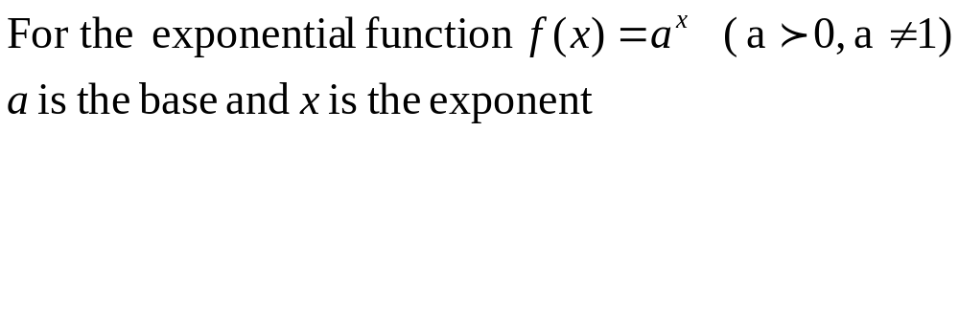
Cont’d

Slide 5
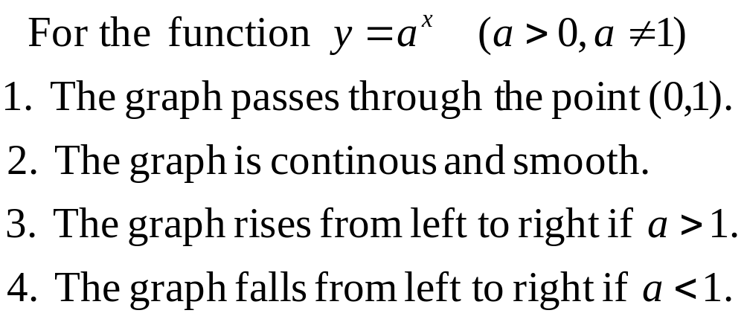
PROPERTIES OF EXPONENTIAL FUNCTIONS

Slide 6
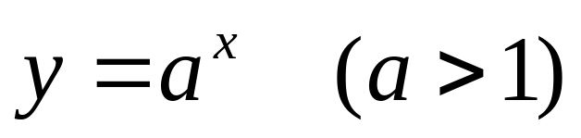
EXPONENTIAL GRAPH
y
y = 1
x

Slide 7
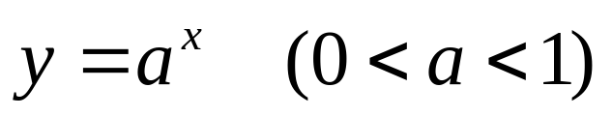
EXPONENTIAL GRAPH
y
y = 1
x

Slide 8
LOGARITHM
Defn: A logarithm is the exponent or index to which a base is raised to get the given number
In 4³=64
3 is the logarithm and the above expression 4³=64 is written as log₄64=3
log₄64=3 is read as the logarithm of 64 to base 4 is 3

Slide 9
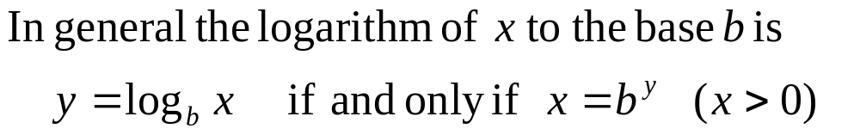
Cont’d

Slide 10
LOGARITHM
  For x>0 and b>0, b≠1,
  y = log_{b}x is equivalent to b^{y} = x
  The function f(x) =log_{b}x is the logarithmic function with base b

Slide 11
Base and exponent in exponential and logarithmic forms
Logarithmic form
y = log_{b}x
Exponential form
b^{y} = x
Exponent
Exponent
Base
Base

Slide 12
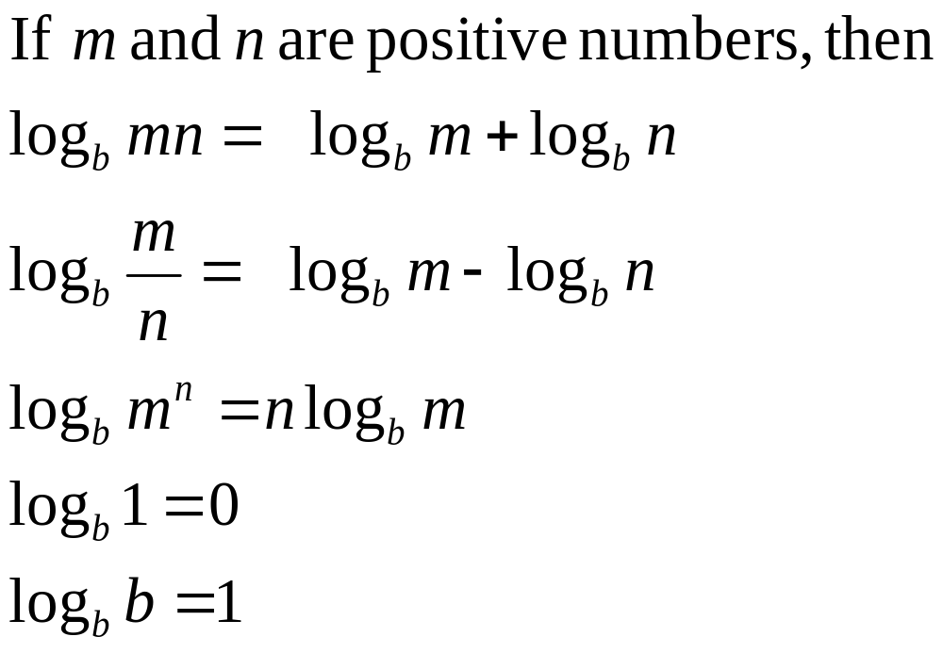
LAWS OF LOGARITHMS
jkg/10

Slide 13
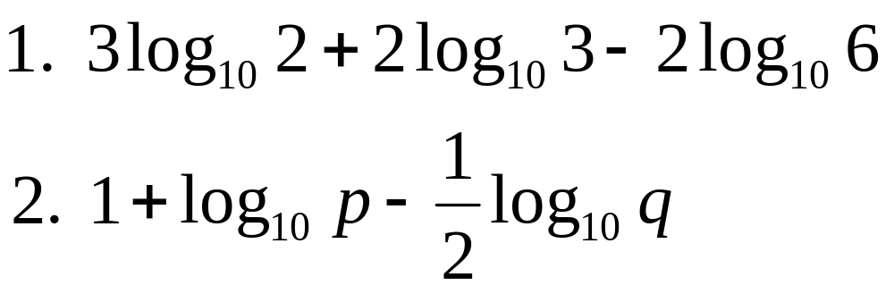
EXERCISE
Express as a single logarithm:

Slide 14
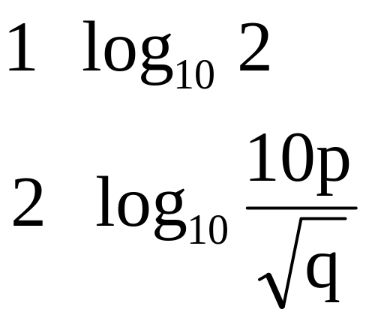
Solutions

Slide 15

GRAPH OF LOGARITHMIC FUNCTION
y
1
x
1

Slide 16


Graphs of Exponential and Logarithmic Functions
y
Exponential
1
x
1
Logarithmic

Slide 17
LOGARITHMIC NOTATION
Two commonly used logarithms
Common Logarithm
Natural Logarithm

Slide 18
COMMON LOGARITHM
The common logarithm is the logarithm with base 10
This is simply donated as “ log ”
i.e. log₁₀x = log x

Slide 19
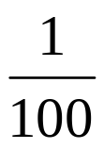

Example: f(x) = log₀ x
Example: Graph the common logarithm function f(x) = log₁₀ x.
x
1
2
4
10
f(x) = log₁₀ x
–2
–1
0
0.301
0.602
1
y
by calculator
f(x) = log₁₀ x
x
5
(1, 0) x-intercept
–5

Slide 20


Common Logarithmic Function
EVALUATING COMMON LOGARITHM (log₁₀)
The LOG key on a calculator is used to obtain common logarithms.
Examples: Find the values using a calculator.
Function Value
Keystrokes
Display
log₁₀ 100
LOG 100 ENTER
2
log₁₀( )
LOG ( 2 5 ) ENTER
– 0.3979400
log₁₀ 5
LOG 5 ENTER
0.6989700
log₁₀ –4
LOG –4 ENTER
ERROR
no power of 10 gives a negative number

Slide 21
NATURAL LOGARITHM
The natural logarithm is the logarithm with base 2.71828 18……..(irrational number)
2.71828 18 is e
Hence the natural logarithm is the logarithm with base e
This is simply donated as “ ln ”
i.e. log_{e}x= ln x

Slide 22

Natural Logarithmic Function
The function defined by f(x) = log_{e} x = ln x
(where x > 0, e 2.718281…)
is called the natural logarithm function.
y = ln x is equivalent to e ^{y} = x

Slide 23
Natural Logarithmic Function
GRAPH OF NATURAL LOGARITHM
y
y = ln x
x
5
–5

Slide 24
EVALUATING ln x
Use a calculator to evaluate: ln 3, ln –2, ln 100
Function Value
Keystrokes
Display
ln 3
ln 3 ENTER
1.0986122
ln –2
ln –2 ENTER
ERROR
ln 100
ln 100 ENTER
4.6051701

Slide 25
Properties of Natural Logarithms
Properties of Natural Logarithms
1. ln 1 = 0 since e⁰ = 1.
2. ln e = 1 since e¹ = e.
3. ln e^{x} = x and e^{ln x} = x
4. If ln x = ln y, then x = y.

Slide 26
CHANGE BASES
Evaluate log₂9 (use calculator)
Note that using calculators, can evaluate log₁₀ and log_{e} and not any other base.
Changing base either to e or 10 is the solution!

Slide 27
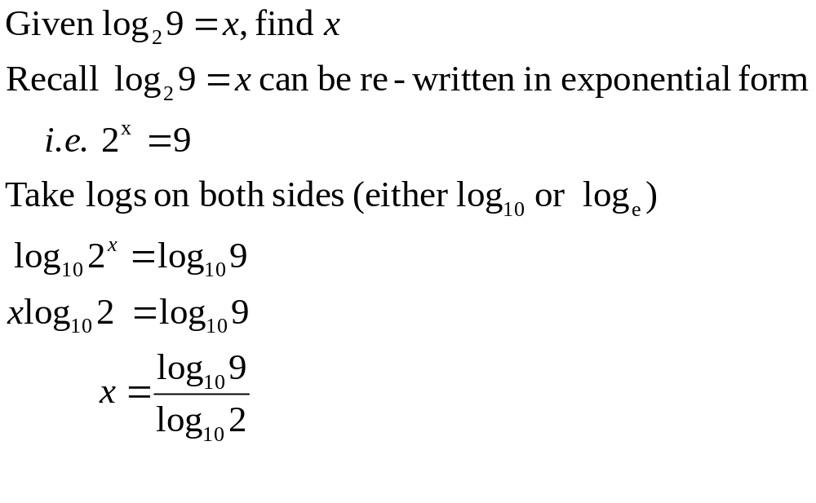
Cont’d

Slide 28
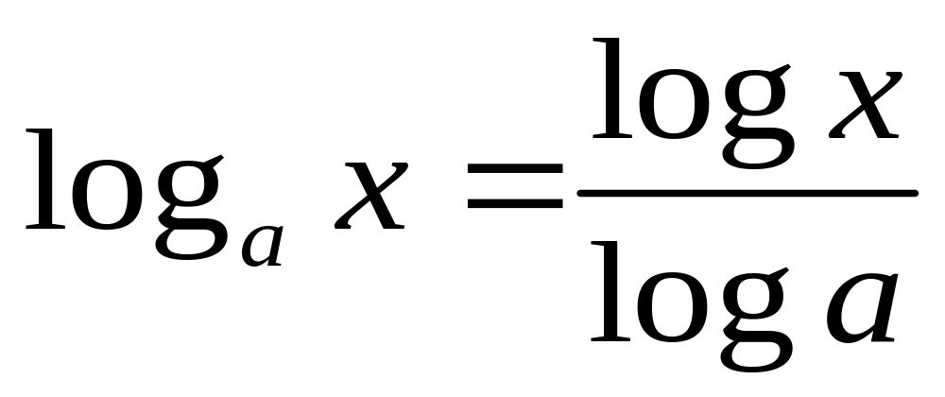
CHANGING LOG BASES
In general

Slide 29
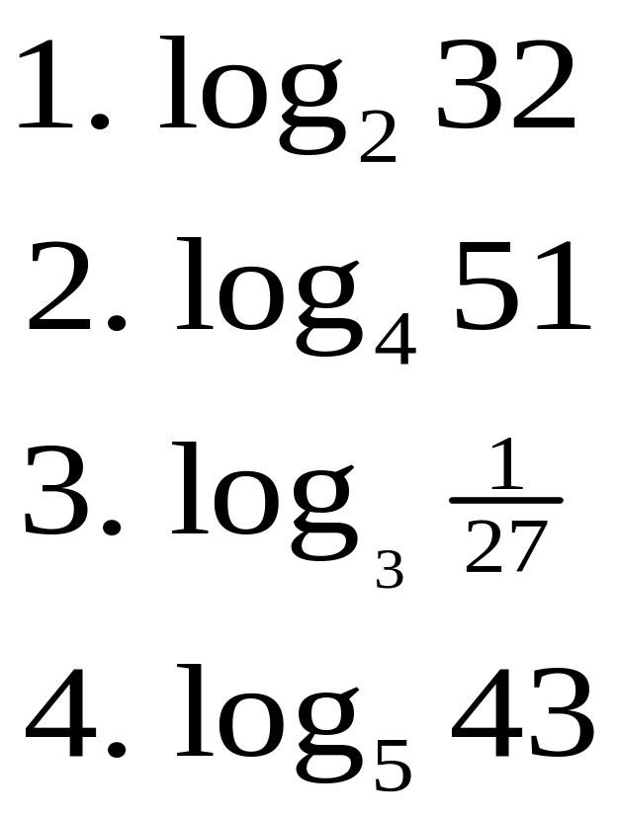
EXERCISE
Evaluate:

Slide 30
SOLUTIONS
5
2.84
-3
2.34

